Slide 1
Lecture 2 & 3
Unified process and UML
By:
Ms. Amina Mustansir
Lecturer PUCIT

Slide 2
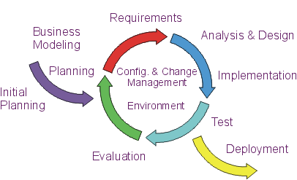
Unified Process :Introduction
A software development iterative process using OOAD
UP combines commonly accepted best practices, such as iterative life cycle and risk-driven development

Slide 3
Salient Features
  Iterative Development
  Risk Driven development
  Requirements Management
  Component-Based Architectural Vision
  Visual Modeling of Systems
  Quality Management
  Change Control Management
  Time Boxing

Slide 4
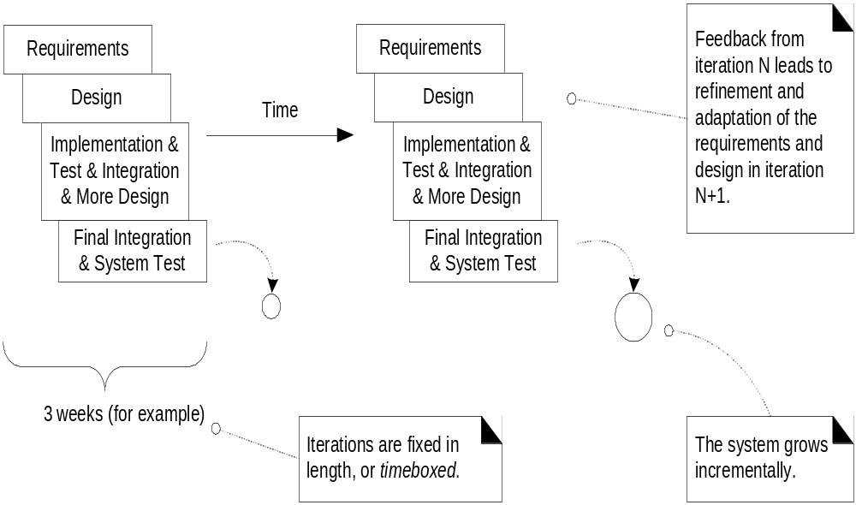
Iterative and Incremental development

Slide 5
Iterative development
1st Iteration
2nd Iteration
Requirement
Requirement
Design
Design
Implement, test
& Integrate
Implement, test
& Integrate
FEEDBACK
TIME

Slide 6
Goals and Features of Each Iteration
The primary goal of each iteration is to slowly chip away at the risk facing the project, namely:
  performance risks
  integration risks (different vendors, tools, etc.)
  conceptual risks (ferret out analysis and design flaws)
Perform a “mini waterfall” project that ends with a delivery of something tangible in code, available for scrutiny by the interested parties, which produces validation or correctives
Each iteration is risk-driven
The result of a single iteration is an increment--an incremental improvement of the system, yielding an evolutionary approach
Time boxing; an iteration should be of fixed in length

Slide 7
Benefits of Iterative development
Recognizes the reality of changing requirements
  Caspers Jones’s research on 8000 projects
    40% of final requirements arrived after the analysis phase, after development had already begun
Feed back and adaptation; it embrace changes , rather than fighting the inevitable changes in development due to freezing requirements it follows change management.
Promotes early risk mitigation, by breaking down the system into mini-projects and focusing on the riskier elements first
Allows you to “plan a little, design a little, and code a little”, resulting in Complexity management
Encourages all participants, including client, programmer, testers, integrators, and technical writers to be involved earlier; in feed back and domain understanding that leads to a refined system that more closely meets the real requirements of client.
Allows the process itself to modulate with each iteration, allowing you to correct errors sooner and put into practice lessons learned in the prior iteration, leading to development process improvement

Slide 8
Focuses on component architectures, not final big bang deployments
Allows for software to evolve, not be produced in one huge effort
Allows software to improve, by giving enough time to the evolutionary process itself
Forces attention on stability, for only a stable foundation can support multiple additions
Allows the system (a small subset of it) to actually run much sooner than with other processes, leading to early display
Allows for the management of risk, by exposing problems earlier on in the development process
Model software visualizing through UML

Slide 9
Agile UP
Processes can be
    Heavy/Predictive
    Light/Adaptive
UP is an Agile process implies a light and adaptive process, nimble in response to changing needs

Slide 10
The Rational Unified Process
RUP is a method of managing OO Software Development, introduced by Rational co
It can be viewed as a Software Development Framework which is extensible and features:
  Iterative Development
  Requirements Management
  Component-Based Architectural Vision
  Visual Modeling of Systems
  Quality Management
  Change Control Management

Slide 11
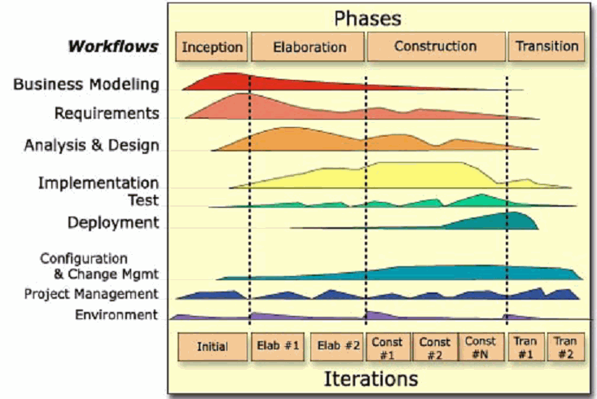
Organization by CONTENT
Organization by TIME

Slide 12
UP Phases
Inception
Requirement
Elaboration
Design
Construction
Implementation
Transition
Deployment

Slide 13
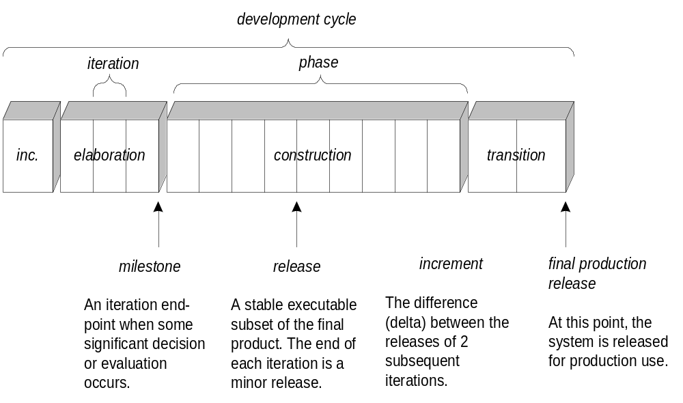
Schedule Oriented Terms

Slide 14
UP Disciplines
Business Modeling
Requirements
Design
Implementation
Test
Deployment
Configuration and Change Management
Project management
Environment

Slide 15
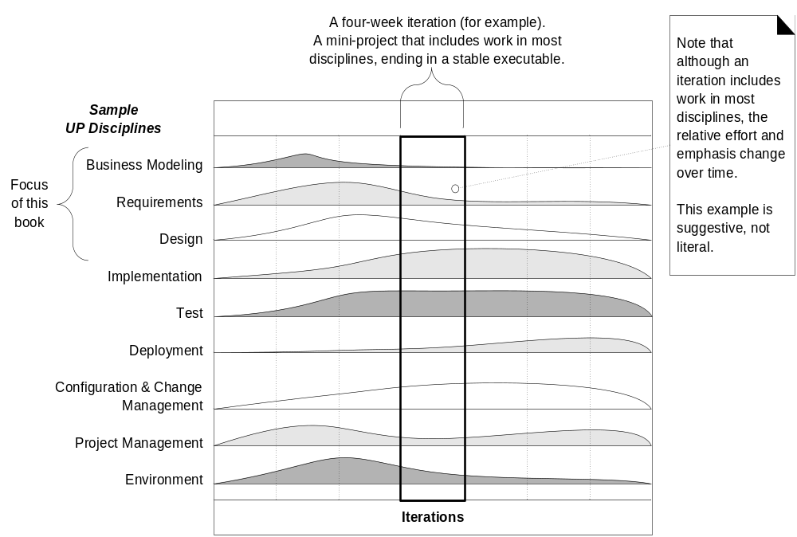
UP disciplines

Slide 16
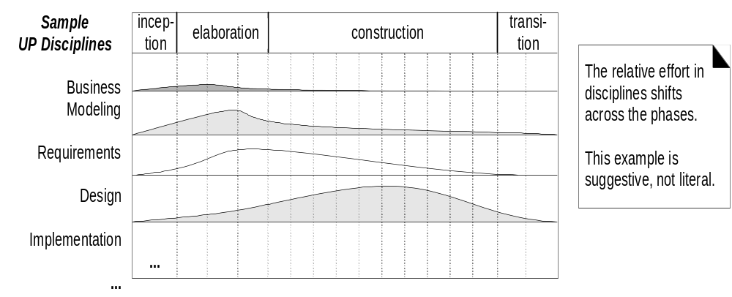
Disciplines and Phases

Slide 17
UP Phases an overview

Slide 18
Inception Phase
Approximation of vision, business case, scope and vague estimates
  Initial requirements capture
  Cost Benefit Analysis
  Initial Risk Analysis
  Project scope definition
  Defining a candidate architecture
  Development of a disposable prototype
  Initial Use Case Model (10% - 20% complete)
  First pass at a Domain Model

Slide 19
Elaboration Phase
Refined vision, iterative implementation of the core architecture, more realistic estimates
Requirements Analysis and Capture
  Use Case Analysis
    Use Case (80% written and reviewed by end of phase)
    Use Case Model (80% done)
    Scenarios
      Sequence and Collaboration Diagrams
      Class, Activity, Component, State Diagrams
  Glossary (so users and developers can speak common vocabulary)
  Domain Model
    to understand the problem: the system’s requirements as they exist within the context of the problem domain
  Risk Assessment Plan revised
  Architecture Document

Slide 20
Construction Phase
Iterative development of the remaining lower risk and easier elements and preparation for deployment
Focus is on implementation of the design:
  cumulative increase in functionality
  greater depth of implementation (stubs fleshed out)
  greater stability begins to appear
  implement all details, not only those of central architectural value
  analysis continues, but design and coding predominate

Slide 21
Transition Phase
Beta Tests and Deployment
The transition phase consists of the transfer of the system to the user community
It includes manufacturing, shipping, installation, training, technical support and maintenance
Development team begins to shrink
Control is moved to maintenance team
Alpha, Beta, and final releases
Software updates
Integration with existing systems (legacy, existing versions, etc.)

Slide 22
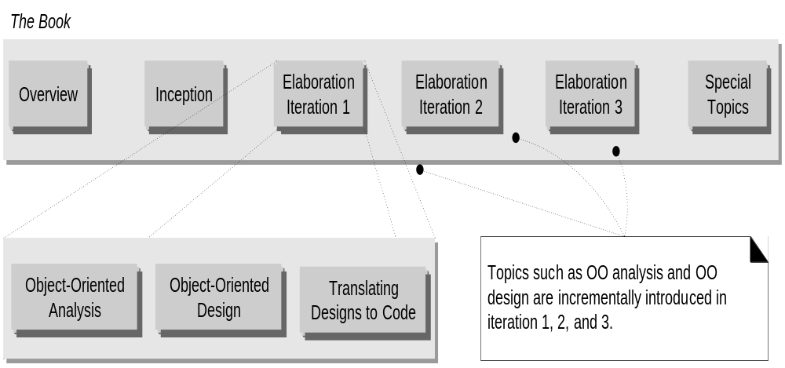

Slide 23


Slide 24
Unified Modeling Language
    The Unified Modeling Language (UML) is a language for specifying, visualizing, constructing, and documenting the artifacts of software systems, as well as for business modeling and other non software systems [OMG]
UML
2.0
1994
Rumbaugh
UML
1.5
OMT
1996
Mar. 1999
Booch
UML
0.9
UML
1.1
Nov. 1997
OOSE
(Jacobson et al.)
UML HISTORY

Slide 25
What is the UML*?
UML stands for Unified Modeling Language
The UML combines the best of the best from:
  Data Modeling concepts (Entity Relationship Diagrams)
  Business Modeling (Work Flow)
  Object Modeling
  Component Modeling
The UML is a standard language for specifying, visualizing, documenting and constructing the artifacts of a software-intensive system
It can be used with all processes, throughout the development life cycle, and across different implementation technologies

Slide 26
UML Usage: Overview
The UML may be used to:
  Represent the Elements of a system or a domain and their Relationships in a Static Structure using class and object diagrams
  Model the Behavior of objects with state transition diagrams
  Reveal the Physical Implementation Architecture with component & deployment diagrams
  Display the Boundary of a System & its major Functions using use cases and actors
  Illustrate Use Case Realizations with interaction diagrams

Slide 27
UML for Information Modeling
Provides a uniform modeling formalism and a set of (object-oriented) constructs (notation) for representing the elements of a domain of interest as well as their relationships in a Static Structural Model
Use Cases can be used to model usage
Example (DMTF, IETF): development of a common model to serve as an underlying information framework for the specification of a common directory schema; the common model & schema support the operation of multiple applications and systems in the enterprise

Slide 28
UML: Basic Types of Concepts
Modeling elements
Relationships
Diagrams

Slide 29
Basic Modeling Elements
Structural elements
  type, class, instance, collaboration, use case, component, node
Behavioral elements
  interaction, state machine
Grouping elements
  package, subsystem

Slide 30
Classes and Instances
Specifications for one or more distinct objects with a common form (structure and behavior)
instance
class
phone1:Telephone
busy = true
offHook()
onHook ()
ring()
Telephone
phone2:Telephone
busy : boolean
busy = false
offHook()
onHook ()
ring()
offHook()
onHook ()
ring()

Slide 31
Attributes
The data/static structure aspect of a class is represented by its attributes
Attributes may be found by examining class definitions, the problem requirements, and by applying domain knowledge
CourseOffering
Each course offering
has a number, location
and time
number
location
time
Notes:
27

Slide 32
Operations
The behavior of a class is represented by its operations
Operations may be found by examining interaction diagrams
registration
registration
form
manager
RegistrationManager
addCourse(joe, math 01)
addCourse(Student,Course)
Notes:
26

Slide 33
Relationships
Relationships provide a pathway for communication between objects
Sequence and/or collaboration diagrams are examined to determine what links between objects need to exist to accomplish the behavior -- if two objects need to “talk” there must be a link between them
Copyright © 1997 by Rational Software Corporation
Notes:
29

Slide 34
Models and Diagrams
A model is a complete
description of a system
from a particular
perspective
State
Diagrams
State
Diagrams
Class
Diagrams
Use Case
Diagrams
Use Case
Diagrams
State
Diagrams
Use Case
Diagrams
Use Case
Diagrams
State
Diagrams
Use Case
Diagrams
Object
Diagrams
Sequence
Diagrams
Scenario
Diagrams
State
Diagrams
Scenario
Diagrams
State
Diagrams
Collaboration
Diagrams
Component
Diagrams
Models
Scenario
Diagrams
Component
Diagrams
Scenario
Diagrams
Component
Diagrams
Statechart
Diagrams
Deployment
Diagrams
Activity
Diagrams

Slide 35
Modeling
Model
  Sketch/blueprint of a system under consideration or
  A complete representation of a system from a particular viewpoint
  An aggregation of a set of views from specific perspectives.
    Looking at the outside world --- an interpreted reality
      we model
        Context, requirements, practices, constraints etc.
    Looking at the product --- a constructed reality
      we model
        Architecture, specification, design, implementation, deployment etc
Modeling
  In general process by which we develop a model. Specifically the designing of software applications before coding. Modeling is an Essential Part of large software projects, and helpful to medium and even small projects as well. A model plays the analogous role in software development that blueprints and other plans (site maps, elevations, physical models) play in the building of a skyscraper.

Slide 36
.
Surveys show that large software projects have a huge probability of failure - in fact, it's more likely that a large software application will fail to meet all of its requirements on time and on budget; so a model keeps you in cost and time limits

Slide 37
Why Build Models?
Modeling assures that
    Properly understanding of domain is done
    Business functionality is complete and correct
    To communicate with stakeholders
    End-user needs are met
    Program design is plane
    To find errors or omissions
    Program design supports requirements for scalability,robustness, security, extendibility, and other characteristics, as after implementation changes would be difficult and expensive to make
    To generate code

Slide 38
UML Model Views
Requirements (use case diagrams)
Static structure (class diagrams)
  kinds of objects and their relationships
Dynamic behavior (state machines)
  possible life histories of an object
Interactive behavior (activity, sequence, and collaboration diagrams)
  flow of control among objects to achieve system-level behavior
Physical implementation structures (component and deployment diagrams)
  software modules and deployment on physical nodes

Slide 39
Views
  Views represents a partial aspect or properties of a software system
  Each view presents details of the system at a particular level
  Provides the basis for UML notation of a Model
  Not formally included in UML but present in RUP
    Use case View (Use case Model)
    Logical View (Design Model)
    Implementation View (Implementation Model)
    Process View (Process Understanding)
    Deployment View ( Deployment Model)

Slide 40
Diagrams
A diagram is a view into a model
  Presented from the aspect of a particular stakeholder
  Presentation in form of specific Notations and designing features
  Provides a partial representation of the system
  Is semantically consistent with other views
  Provides a partial representation of the system in a graphical way
In the UML, there are nine standard diagrams
  Static views: use case, class, object, component, deployment
  Dynamic views: sequence, collaboration, statechart, activity

Slide 41
Some Diagrams

Slide 42
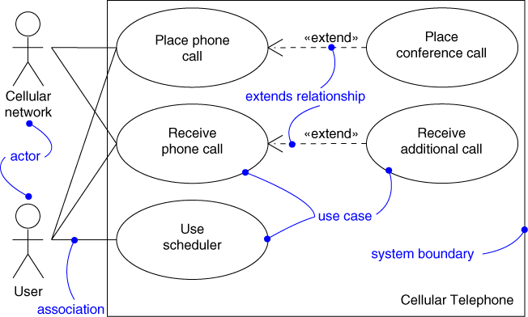
Use Case Diagram
Captures system functionality as seen by users

Slide 43
Use Case Diagram
Captures system functionality as seen by users
Built in early stages of development
Purpose
  Specify the context of a system
  Capture the requirements of a system
  Validate a system’s architecture
  Drive implementation and generate test cases
Developed by analysts and domain experts

Slide 44
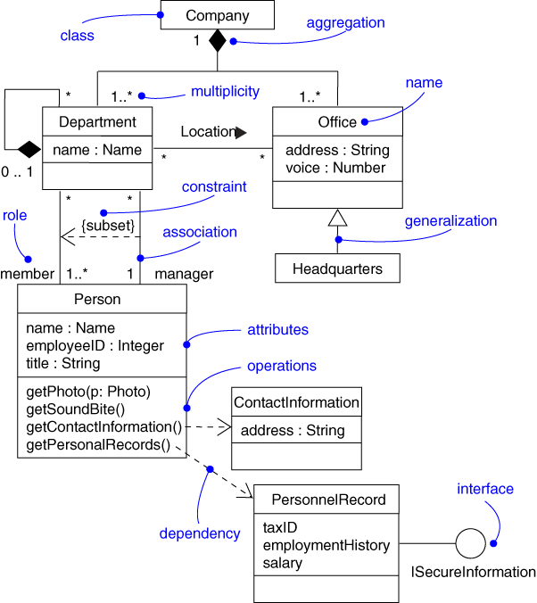
Class Diagram
Captures the vocabulary of a system

Slide 45
Class Diagram
Captures the vocabulary of a system
Built and refined throughout development
Purpose
  Name and model concepts in the system
  Specify collaborations
  Specify logical database schemas
Developed by analysts, designers, and implementers

Slide 46
Class Diagram: Example
Shows the entities in a system and their general relationships
client
creditor
Financial
Institution
Person
0..*
0..*
owner
0..*
generalization
association
Bank
Trust
Company
residence
0..*
House

Slide 47
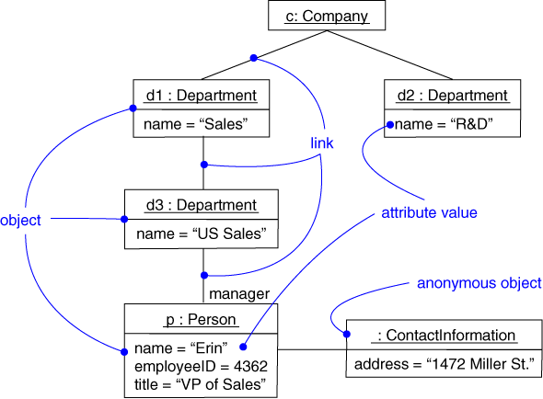
Object Diagram
Captures instances and links

Slide 48
Object Diagram
Shows instances and links
Built during analysis and design
Purpose
  Illustrate data/object structures
  Specify snapshots
Developed by analysts, designers, and implementers

Slide 49
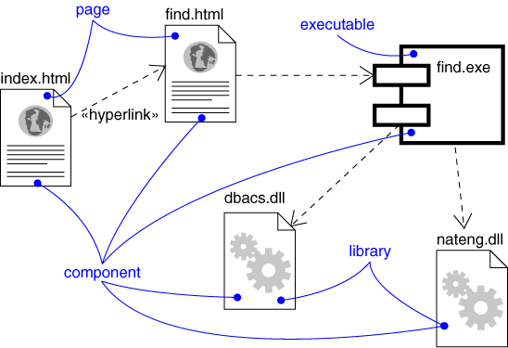
Component Diagram
Captures the physical structure of the implementation

Slide 50
Component Diagram
Captures the physical structure of the implementation
Built as part of architectural specification
Purpose
  Organize source code
  Construct an executable release
  Specify a physical database
Developed by architects and programmers

Slide 51
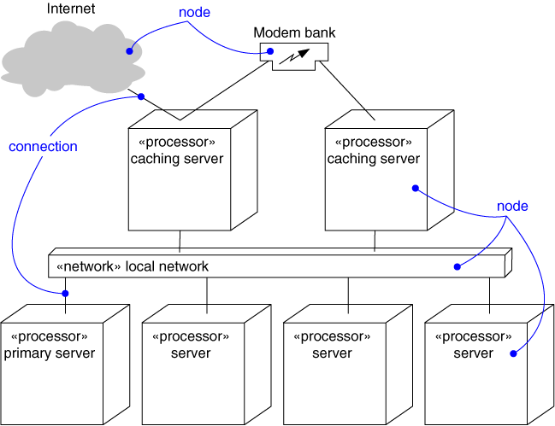
Deployment Diagram
Captures the topology of a system’s hardware

Slide 52
Deployment Diagram
Captures the topology of a system’s hardware
Built as part of architectural specification
Purpose
  Specify the distribution of components
  Identify performance bottlenecks
Developed by architects, networking engineers, and system engineers

Slide 53
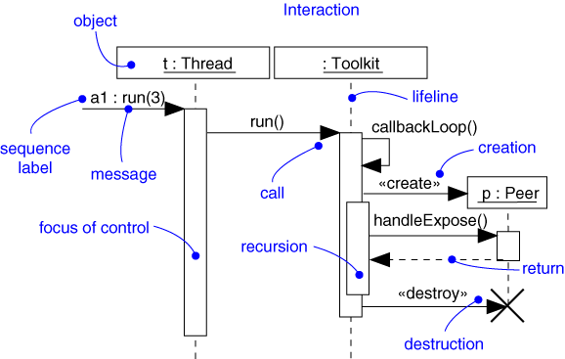
Sequence Diagram
Captures dynamic behavior (time-oriented)

Slide 54
Sequence Diagram
Captures dynamic behavior (time-oriented)
Purpose
  Model flow of control
  Illustrate typical scenarios

Slide 55
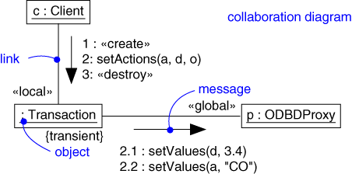
Collaboration Diagram
Captures dynamic behavior (message-oriented)

Slide 56
Collaboration Diagram
Captures dynamic behavior (message-oriented)
Purpose
  Model flow of control
  Illustrate coordination of object structure and control

Slide 57
Collaboration Diagram: Example
A collaboration diagram displays object interactions organized around objects and their links to one another
course form :
CourseForm
1: set course info
2: process
: Registrar
3: add course
aCourse :
theManager :
CurriculumManager
Course
4: new course
Notes:
22

Slide 58
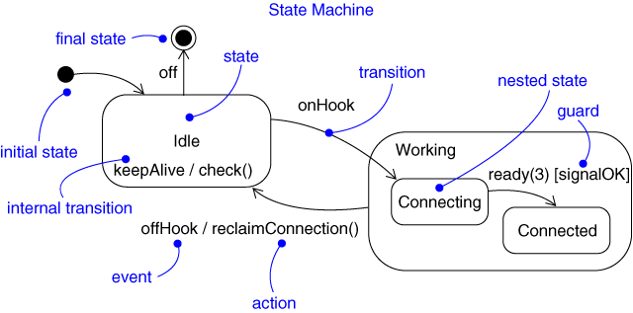
Statechart Diagram
Captures dynamic behavior (event-oriented)

Slide 59
Statechart Diagram
Captures dynamic behavior (event-oriented)
Purpose
  Model object lifecycle
  Model reactive objects (user interfaces, devices, etc.)

Slide 60
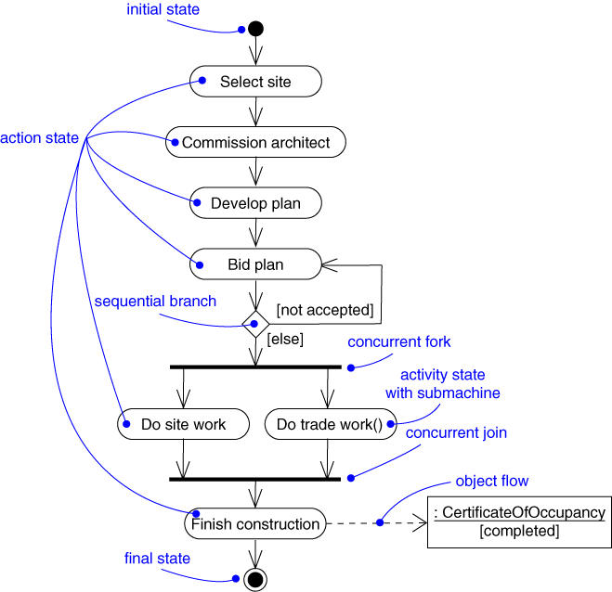
Activity Diagram
Captures dynamic behavior (activity-oriented)

Slide 61
Summary: the UML
An industry standard for analysis and design of object-oriented systems
  based on extensive experience and best practices
  gaining rapid acceptance (training, tools, books)
Comprises:
  set of modeling concepts
  graphical notation
Concepts are organized into diagram types
  class, state machine, collaboration, use case, sequence, activity, component, deployment
The UML can be used in many different domains to capture domain-specific concepts and ideas

Slide 62
Announcement:
Project (Announcement # 1)
  Establish Groups (not more than 4 members)
  Find a project (DO Consider Time, No of Group members and Domain)
  Submit Project Proposal on 6th Lecture (Before start of lecture ; no proposal will be entertained afterwards)
  Be prepare for a Project proposal Meeting; Time schedule will be up loaded on Teacher Notes

Slide 63
REFFERENCES
TEXT BOOK ARTICLE REFFERENCES:
  1.6, 2.1, 2.2, 2.3, 2.4, 2.5, 2.6, 3.1 3.2
SITE REFFERENCES:
  http://www.omg.org/gettingstarted/what_is_uml.htm

Slide 64
Other References
Grady Booch, James Rumbaugh, Ivar Jacobson, The Unified Modeling Language User Guide, Addison-Wesley, 1999.
UML documentation - http://www.rational.com/uml/resources
“UML in Action,” Communications of the ACM, October 1999, V. 42, N. 10
Whitepapers:
  (1) "Why Use the UML?" by Martin Fowler
  (2) "How the UML Models Fit Together," by Scot Ambler
  (3) "UML Applied: Nine Tips to Incorporating UML into Your Project" by D. Rosenberg
  (1) ,(2) and (3) are available at http://www.sdmagazine.com/uml (Focus on UML).
  There are several whitepapers on UML available at “The UML Home” http://www.rational.com/uml/resources/whitepapers -

